Slide 1
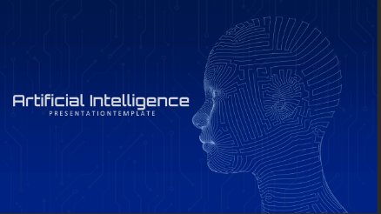
Artificial Intelligence (AI)
BY Muhammad UMAR

Slide 2
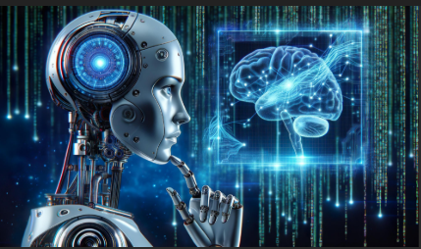
Contents
Introduction to AI
History of AI
Types of AI
Applications of AI
Benefits of AI
Challenges or Risks
Conclusion

Slide 3
Introduction to AI
Artificial Intelligence means creating machines that can think and learn like humans.
It is a branch of computer science.
AI enables computers to make decisions, solve problems, and perform human-like tasks

Slide 4
History of AI
The term Artificial Intelligence was first introduced by John McCarthy in 1956.
In the early years, AI could only solve simple problems.
But today, AI has become more powerful with machine learning and deep learning technologies.

Slide 5
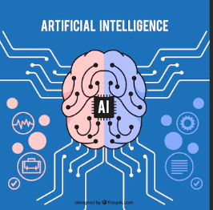
Types of AI
Narrow AI, which works for a specific task like Siri or Alexa.
General AI, which can think like a human — it’s still under research.
Super AI, which is expected to be even smarter than humans in the future.

Slide 6
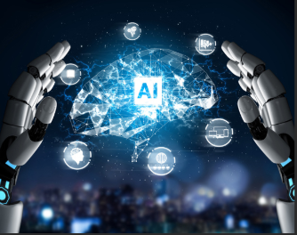
Applications of AI
AI is being used everywhere in our daily life:
In education, for smart learning systems.
In healthcare, to detect diseases.
In transport, for self-driving cars.
In business, through chatbots and automation.

Slide 7
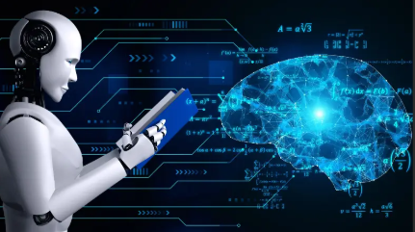
Benefits of AI
The biggest advantages of AI are:
It saves time, increases accuracy, and reduces human error.
It can work continuously without rest and can make fast, logical decisions.

Slide 8
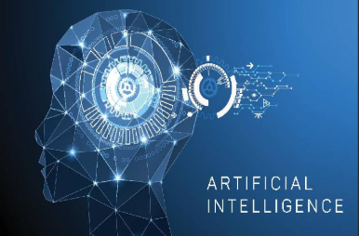
Challenges or Risks
However, AI also has some risks.
It can cause job loss due to automation.
There are concerns about privacy, ethics, and data misuse.
Also, developing AI systems is very expensive.

Slide 9
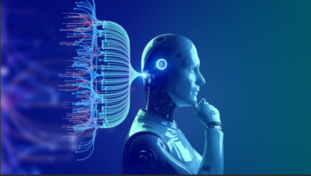
Conclusion
In conclusion,
AI is not just technology — it is a revolution that is changing the world.
If used wisely, it can make our lives better, faster, and more intelligent.
Thank you!

